Slide 1


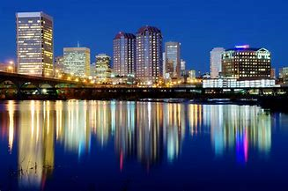

153rd session virginia annual conference
Mrs. Devieta C. Moore, Supervisor
Bishop W. Darin Moore, Presiding Prelate
“The Freedom Church: Refocusing on Our Purpose, Reviewing Our Practices, Retooling Our People, Reaching Our Potential”

Slide 2

Christians today are looking for all sorts of different things in a church:
So, what are you looking for in a church?
Vibrant Music Ministry with a praise team or choir
Good preaching – biblical but not boring, practical but not picky
A Pastor who is relatable, not too serious or traditional
A place where the people are at the same place in life as me
Where youth and children are present

Slide 3
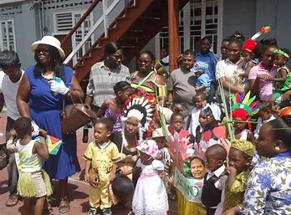

what should a church be?
A church that is welcoming
Passionate
Authentic
Big
Intimate
exciting

Slide 4
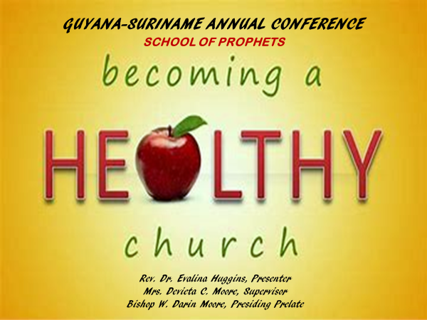



Slide 5
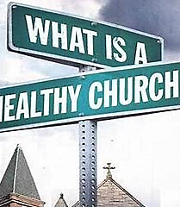

Presentation Goals
To examine some possibilities for establishing increasingly HEALTHY CHURCHES and HEALTHY CONGREGATIONS. This presentation will explore leadership models, various perspectives and our motivation for seeking simultaneously HEALTHY CONGREGATIONS AND HEALTHY CHURCHES. The important thing to note is that you cannot have one without the other.

Slide 6
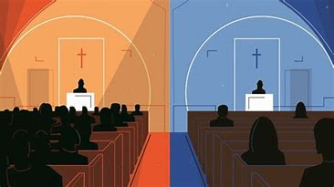

objectives
To explore models for increasingly healthy congregations and people
To explore the role of the LEADERSHIP in cultivating healthy congregations and healthy people
To explore issues of preaching, personal theology, a biblical understanding of the gospel, conversion, membership, Discipline and the Church as Christ’s bride..

Slide 7


No one prescription will work for anybody. Just as your doctor prescribes you medication based on various factors such as your weight, other conditions, or other medications you are taking, so it is with the church and those who are members of the church.
My medication may cause you to become ill or suffer adverse reactions; therefore I must warn you that there is no one single prescription for having a healthy church or congregation. What may work for one, may cause the other to become ill…

Slide 8
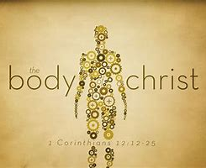
Healthy churches are marked by:
Romans 12: 3-8
Honest Evaluation (v. 3)
We must avoid edifying ourselves
We must have a realistic view of ourselves… flaws in all!
We must intentionally balance overconfidence (pride) with humility
FAITHFUL COOPERATION (v. 4-5)
The body has many parts (visible and invisible), not just the HEAD.
Every part of the body is important
Every part of the body depends on another (While each has a different function, Jesus is the tie that binds)
INDIVIDUAL PARTICIPATION (6-8)
Every believer has at least one gift according to I Peter 4:10
No believer has all the gifts (although more than one can operate at the same time)
Gifts equip us to serve the Body of Christ (they are perverted gifts when we use them to serve ourselves)

Slide 9
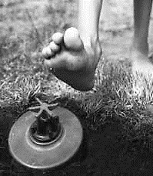
We cannot diagnose ourselves… honest evaluation
In an attempt to be contemporary and relevant, even the most prepared leader makes mistakes. In fact we learn by stepping at times on land mines along the way… but they should never cause us to loose focus of our hearts desire to have a HEALTHY CHURCH. As a church leader, we have a high calling:
The criticism is high and The cost is great
The pressure is intense
Dangers are everywhere
BUT, NEVER ATTEMPTING TO CROSS THE BATTLEFILED IS NOT AN OPTION

Slide 10
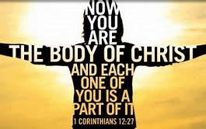
Faithful cooperation – A church working together is a signature mark of a congregation becoming increasingly healthy.
God has arranged the parts in the body, every one of them, just as he wanted them to be. If they were all one part, where would the body be? As it is, there are many parts but one body. The eye cannot say to the hand, “I don’t need you!” And the head cannot say to the feet, “I don’t need you!”
1 CORINTHIANS 12: 18-21

Slide 11

Individual participation
Paul reminds us that we all have different gifts. In the Greek gifts means Charismata, which is where we get the word charismatic; charisma or “grace gift”. The mark of an increasingly healthy church is where multiple gifts are at work to edify the body (prophecy, service, teaching, encouraging, giving, leadership and mercy)

Slide 12


Signs of a healthy church…
Now that we have explored the mark(s) of an increasingly healthy church and healthy congregation, let’s look at some of the signs…

Slide 13
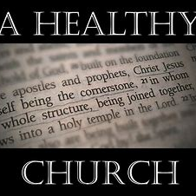
Centrality of the word
Whenever and wherever you find a church and people who hears the Word (preaching), understands the Word (study), and seeks to obey and live the Word (witness)… you are likely to find an increasingly healthy congregation…
If God’s Word is not the authoritative voice in the life of the congregation and people, you will find a church soon likely to die from heart failure… because they do not know, nor are the able to express the heart of God.

Slide 14
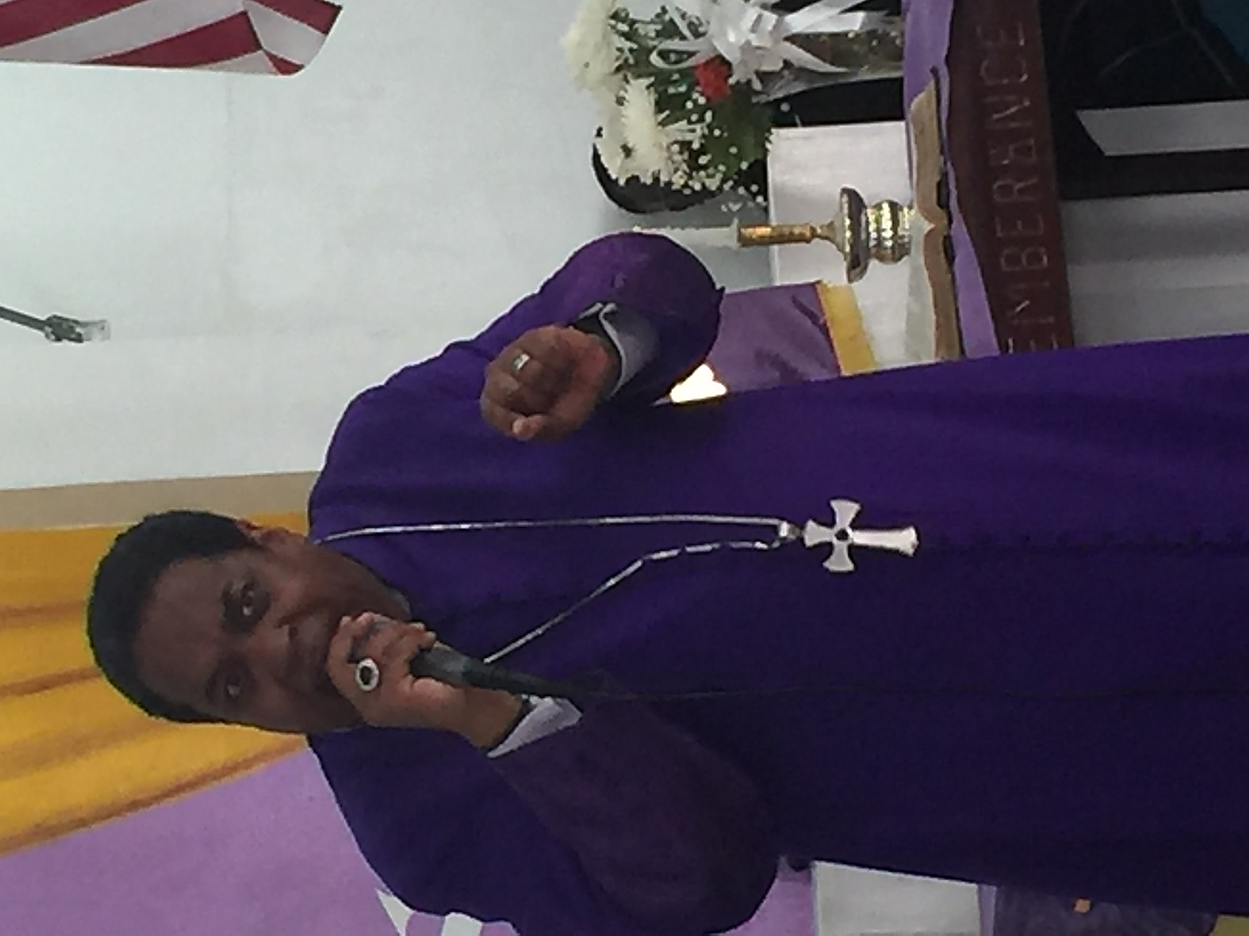
The Centrality of the WORD is the focal point of an increasingly healthy church and congregation, this is accomplished through doctrinally sound biblical teaching and preaching. Believe it or not, sermon study time and its ability to resonate with the people impacts the health of the church.
Our services are getting longer and longer, as we move to longer periods of praise & worship, the insertion of liturgical dance, video and dramatic presentations and even the announcements; and yet, we have cultivated a generation of people who have little time for the WORD of God.
Strong preaching promotes a correalation between conversion, growth and discipleship.

Slide 15
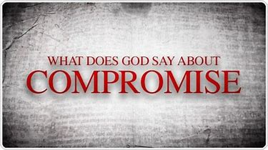
Biblical relevancy
The buzz word today is “Relevant” and in an attempt to be such the church is losing its RELEVANCY. In other words, we must not become comfortable with what everybody else is doing.
Indeed our mission is to meet the needs of our current culture, but at what cost.
While technology is on the rise, social media has become the norm, and digital sermons are on the upswing… who is all this for? I would contend at times US.
The mission of the church is to win the lost, rescue the dying and make disciples; and so, if we are going to use these mediums the goal remains to the same… to reach the lost and make DISCIPLES!
John 12:42-43; Acts 20:20-21, 26-27; Romans 1:16-17;
Galations 1:10; 2 Timothy 4:1-4

Slide 16
We are Called to be relevant = healthy
Relevant defined:
relating to, or bearing upon the matter at hand
connected with what is happening or being discussed
correct or suitable for a particular purpose
important, useful
implies a traceable, significant, logical connection
pertinent, applicable
RELEVANCY DETERMINANTS
The Negotiable vs. the Non-negotiable
Adaptability vs. Compromise
Flexibility vs. Rigidity
Principle vs. Preference
Substance vs. Style
Inclusivity vs. Exclusivity

Slide 17
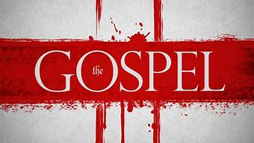
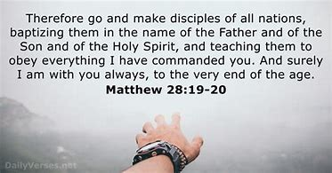
Our witness and personal theology
How do the people in our churches articulate their faith? There is a difference between your theology (what you believe about God and your testimony)
There is a major deficit or inability to those in our churches ability to express let alone live out their faith… I cannot live what I can articulate or explain.
Ask you leaders to tell you, how do they know they are saved

Slide 18
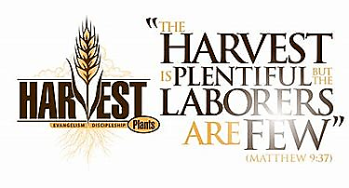
Healthy Churches
Help the lost understand the urgency of coming out of the darkness (sin) into the marvelous light
Help persons navigate their conversion experience – slow, steady growth in Christ..
Help people come to working understanding of sanctification - “holiness”, being set apart
Teach about salvation
Reflect and help it’s members to understand how to live out their salvation daily

Slide 19
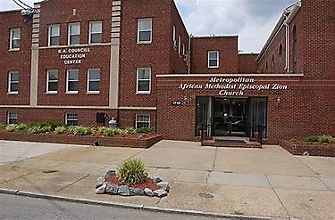
4. What is the role of the local church

Slide 20
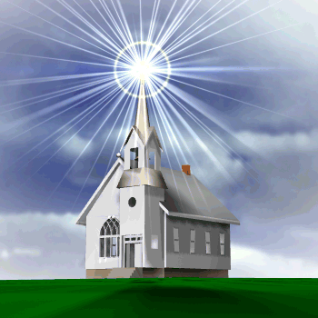
The local church is to reflect the character and nature of god in the world to the extent that the lost come to know a saving god

Slide 21
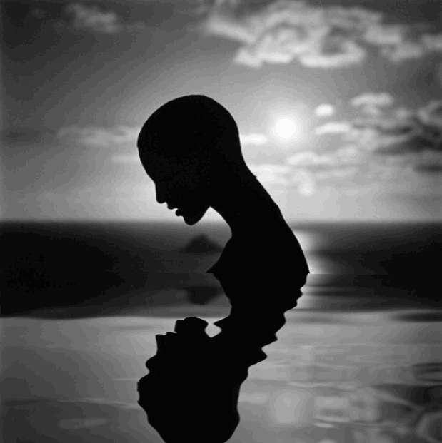
Every church should aspire to be healthy
We must CHOOSE to have healthy churches. We cannot allow this to become cliché’. Healthy denotes a body that’s living and growing as it should… A healthy church is not a perfect church or without sin; but a healthy church is a church that increasingly reflects God’s character as it’s revealed in God’s Word…

Slide 22

To conform to God’s image and character we must listen to God’s voice and obey God’s Word… its just that simple.
By listening and following what God says, we increasingly image his character and glory.
A Healthy Church is an image of God’s
character and glory.
The primary challenge churches face today is not figuring out how to be “relevant” or “strategic” or “inclusively sensitive”, or “vision focused”. It’s figuring out how to be faithful – how to listen, how to trust and obey.

Slide 23
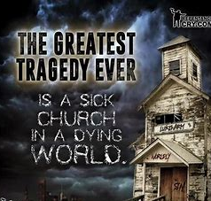

What is an unhealthy church?
Churches who choose to die rather than risk living
Churches who operate in isolation rather than community
Churches who operate in drudgery rather than the joy of serving God and others
Churches who are safe, ‘status quo’ models over those who seek “God-sized” vision and bold creativity
Churches with a fortress mentality, they don’t let anyone in and refuse to allow those on the inside the freedom to explore the frontier or unchartered waters…. Nothing new!
Churches who believe they can address these concerns later rather than NOW…

Slide 24
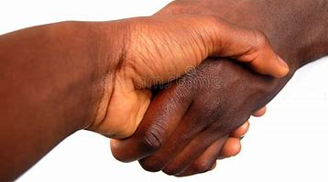
5. Membership and discipline go hand in hand

Slide 25
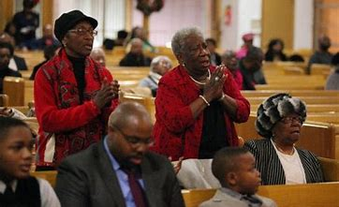
Membership is more than numbers or a statistic, but rather a matter of personal and spiritual integrity… are we inflating numbers, exaggerating our viability and denying the state of our actual health?
Healthy churches take membership seriously

Slide 26

Am I a member?
Membership is the church’s corporate endorsement of a person’s salvation. Wow, are we saying that every member of your church has your endorsement as good Methodist that they are fleeing the wrath to come? Uninvolved members confuse both real members and non-Christians about what it means to be a Christian.
Biblical church membership does not allow persons to be absent months or years without calling them to account, not calling them to perfection but rather to account. How do we know that they are running the race and keeping the faith?

Slide 27
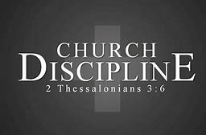
Church membership and church discipline co-exist together. Without discipline the church exposes itself to the enemy…
Since it is the task of leaders to use the giftings of those we lead to create balance in the church we are called to more than simply expounding upon the word, we must be able to protect and correct and delegate and discipline. Discipline protects the church from the work of the enemy…

Slide 28
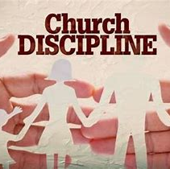
One of the first steps in exercising discipline is to exercise greater care in receiving new members. While its important to instruct people on what the church expects of them, it is even more important to impress upon persons and have them share with you their understanding of what God expects of them.
Care attention to our receiving new members provides less occasion to correct or discipline later

Slide 29

The sign of a health church is its evangelism and corporate prayer

Slide 30
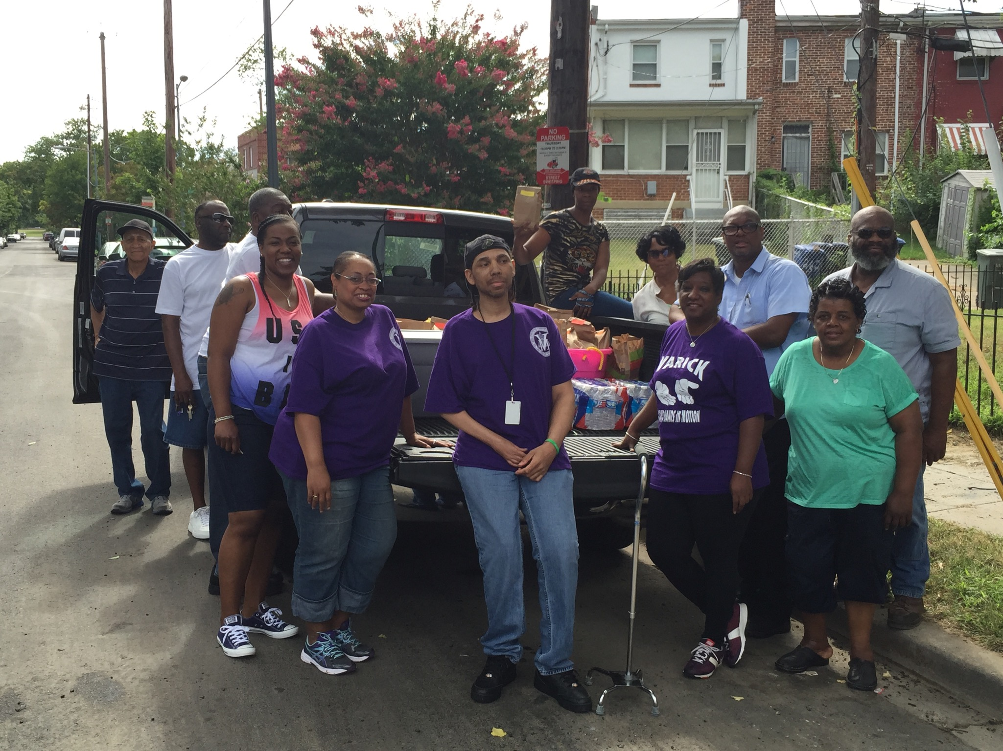
Evangelism Defined
The root of the word evangelism, evangel, is derived from the Greek word EUANGELION which is translated good news. From that same word, we derive the word gospel. Therefore, an “Evangelist” is a person who preaches or teaches the “Gospel”

Slide 31
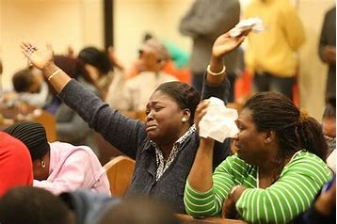
Corporate prayer
A healthy church indicator is when the body gathers corporately in prayer for those who are non-members, unsaved or lost. The external concerns of the church are lifted before God, more than our internal wants.
Praying for the addicted to find refuge in your church, the criminal to be delivered, the captive to be set free and the sinful to find Christ

Slide 32

SMALL GROUPS PROVIDE SAFE PLACES FOR PEOPLE TO SHARE THEIR HURTS, DESIRES, AND DIVINE PURPOSE.
SMALL GROUPS HELP PERSONS TO ESTABLISH THE TRUST NEEDED TO SHARE THEIR STRUGGLES AND YES, EVEN THEIR SINS WITH OTHER BELIEVERS
SMALL GROUPS PROVIDE EXTRAORDINARY OPPORTUNITIES FOR PERSONS TO NAVIGATE THEIR CONVERSION EXPERIENCES, THEIR ONGOING STRUGGLES TO OBTAIN HOLINESS (SANCTIFICATION) AND WHAT IT MEANS TO LIVE OUT THEIR FAITH (SALVATION)

Slide 33

Healthy churches have vibrant small groups, be they:
class leaders
Our ministries,
Sunday school
or a particular demographic
Apart from these groups there must be intentional discipleship, relevant relationship building, and an impactful impartation or sharing of our Christian witness.

Slide 34
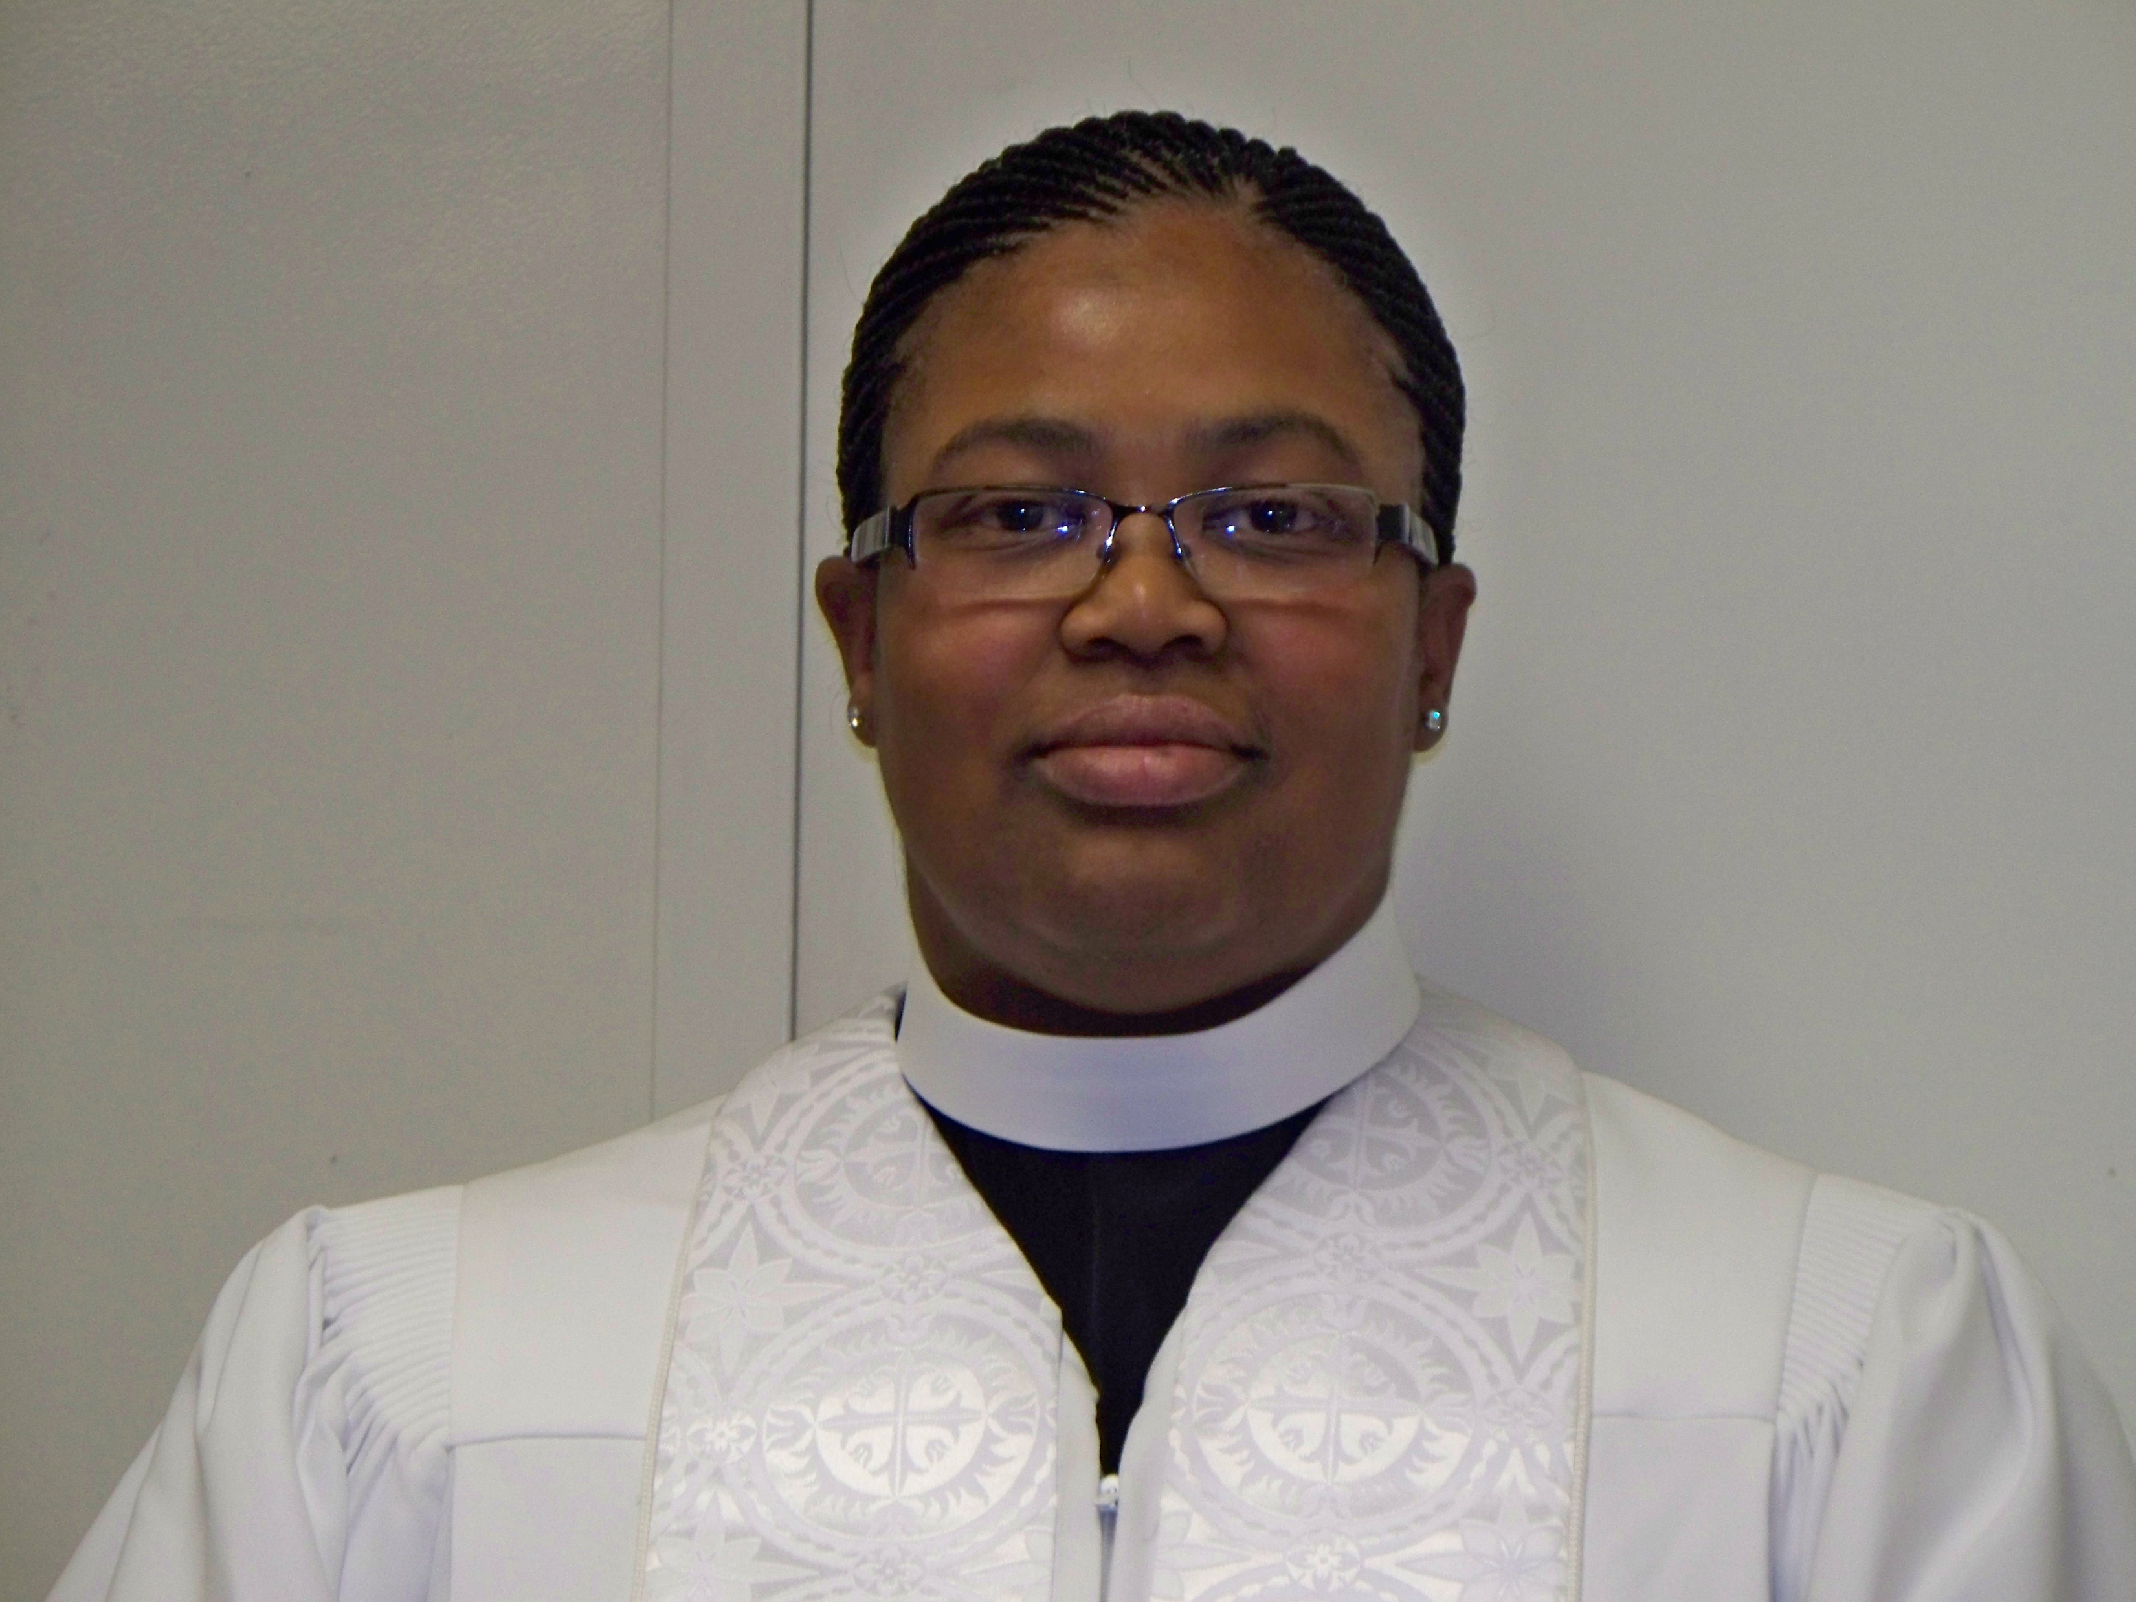
The church is not a place, building or preaching point, but rather… It is a PEOPLE. Christ gave himself for the church (Eph. 5:25) He did not give himself for a place, but for a people who have Jesus at the center of their lives.
Leadership
Leadership must prepare and teach God’s people what the church should be, because Christians today are looking for all sorts of different things in a church, many of which are not rooted and grounded in God’s Word.
Jesus
Family
Job/Career
Life
Church
The Church

Slide 35
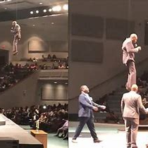
In summation
We must identify what people are looking for in a church -
We must have a clear theology (not understanding), of the church’s mission based upon up a biblical principles… (Book of Acts a good place to start)

Slide 36

In summation
The marks of Healthy churches and congregations are:
Honest evaluation
Faithful cooperation
Individual participation

Slide 37
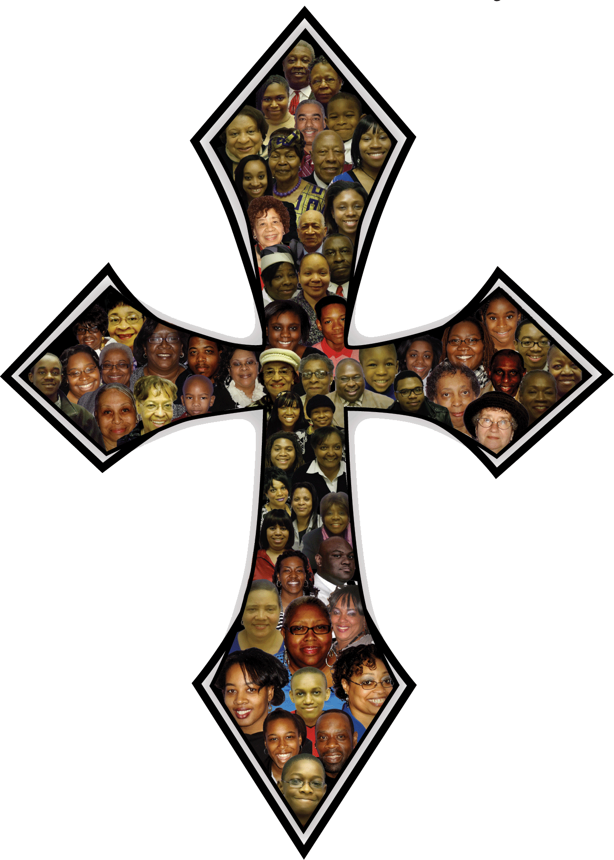
In summation
The signs of Healthy churches and congregations are:
The Centrality of the word
Biblical Relevancy
Having a personal witness and theology
We must be able to articulate and convey to persons the role of the local church
We must convey that membership and discipline go hand in hand
Evangelism and corporate prayer must not be an after thought… IT MUST BE THE DRIVING FORCE BEHIND OUR EVERY EFFORT. TO MAKE DISCIPLES!

