Slide 1
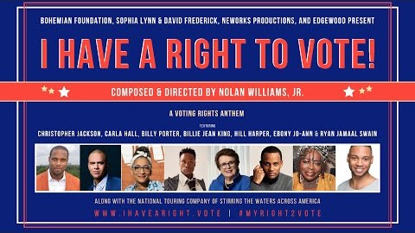
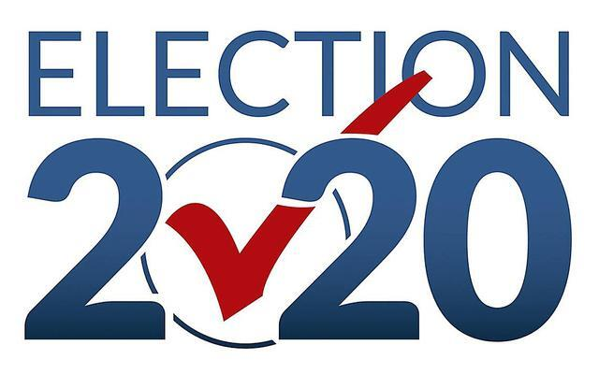
Baltimore District Voter Registration Forum

Slide 2
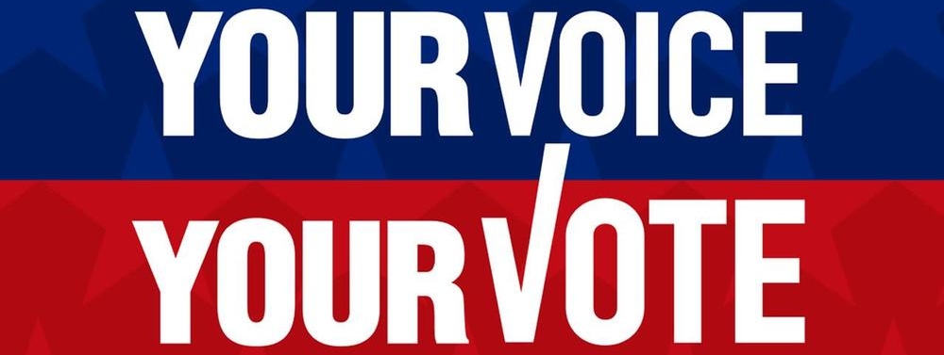
Baltimore District Voter Registration Forum
Rev. Dr. Evalina Huggins, Presiding Elder

Slide 3
Baltimore District Voter Registration Forum
Welcome
Introduction of the Voter Registration Team
Introduction of Panelists
Panelist Presentations
Voting Deadlines Presentation
Q & A

Slide 4
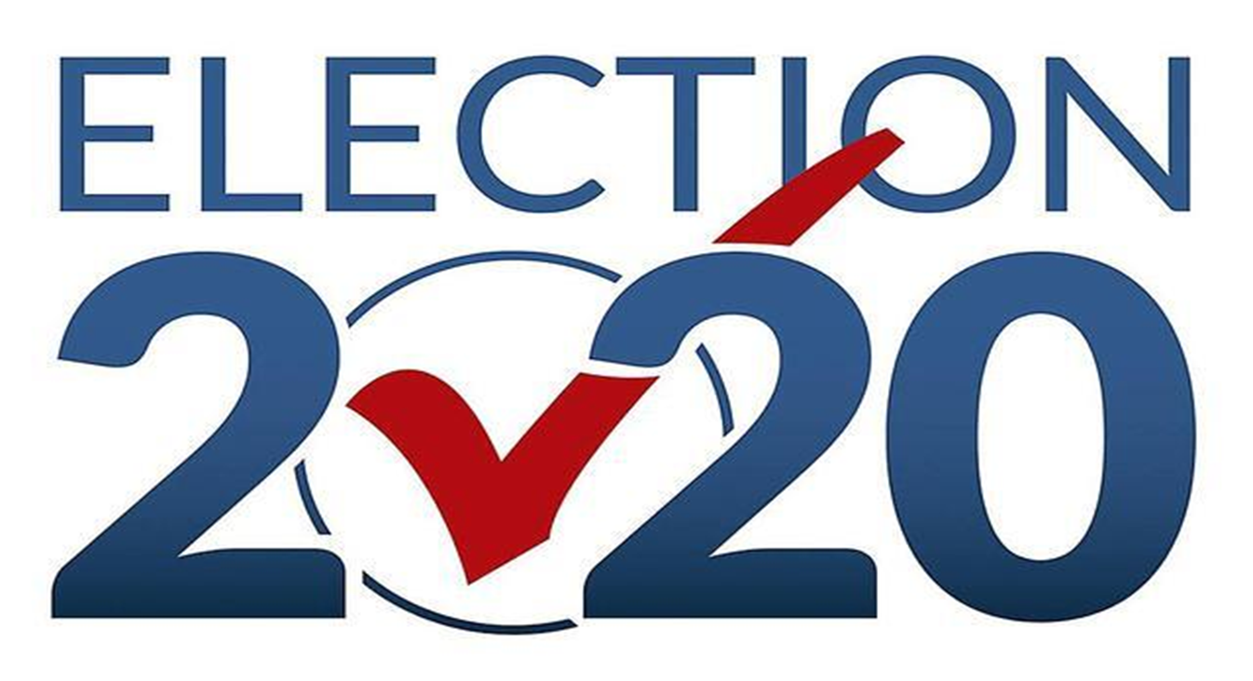
Baltimore District Voter Registration Forum
Leadership Team
Kim Elliott, Co-Chair, Coordinator of Prince Georges County | Chuck Williams, Co-Chair, Coordinator of Montgomery County
Peggy Gullette, Coordinator of City of Baltimore | Francine Jefferson, Coordinator of Baltimore County
Each Local Church has Appointed a
Voter Engagement Coordinator

Slide 5
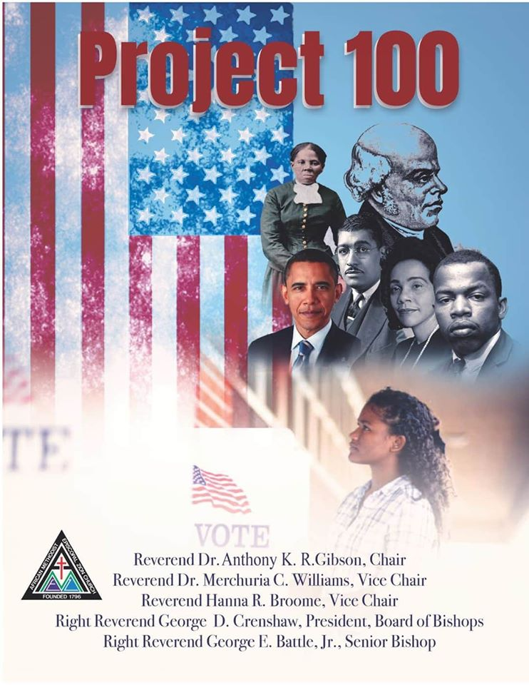
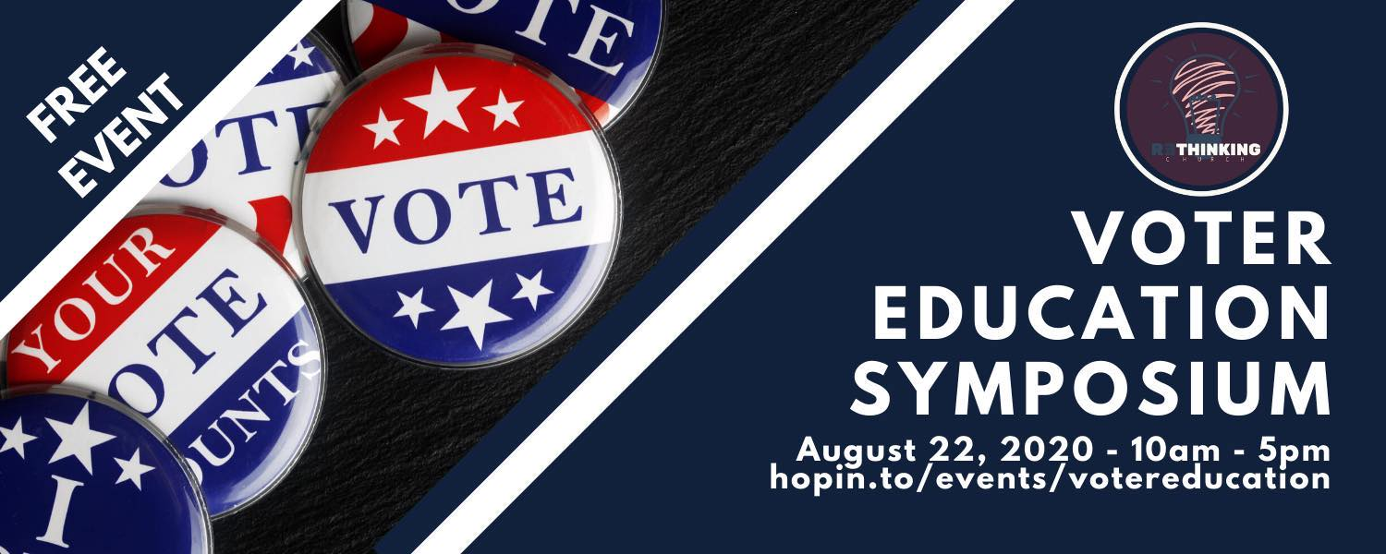
Upcoming Voter Events

Slide 6
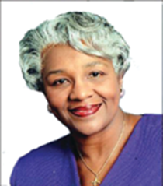
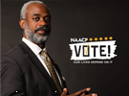
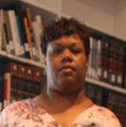
Baltimore District Voter Registration Forum
Voter Registration Panelist:
Dr. Barbara Shaw,
Past International President WHOMS, Past Chair of NCNW,
Representing Black Church 75
Rev. Kobi Little,
President, Baltimore Branch
NAACP
Janet Ross,
Information Technology &
Election Judge Training Manager
Montgomery County Board of Elections

Slide 7

Black Church 75, Inc. is a voter turnout movement of the Religious Affairs Department of the National Action Network in partnership with the Conference of National Black Churches with the goal of mobilizing at least 1,000 black churches in America to register and turnout 75% of their eligible voters.
Dr. Barbara Shaw

Slide 8
THE FOUR R’s
Register
Register & Turnout at least 75% of all eligible voters in their congregations
Ready
Ensure Voters are Ready to vote (photo ID, address, precinct)
Remember
Remind voters to register to vote and to GO VOTE in the upcoming LOCAL and NATIONAL elections.
Rush
Have voters rush to vote early! We MUST HAVE a record turnout of black voters in 2020 general election!

Slide 9

Rev. Kobi Little, President of Baltimore Branch
The purpose and aims of the Baltimore City Branch of the National Association for the Advancement of Colored People is:
to improve the political, educational, social, and economic status of African-Americans and other racial and ethnic minorities;
to eliminate racial prejudice;
to keep the public aware of the adverse effects of discrimination; and
to take lawful action to secure the elimination of racial discrimination, to seek legislation and policies at the local or at other levels, which advance the programs and policies of the Association; and
to oppose legislation and policies which are adverse to the programs and policies of the Association.

Slide 10

Janet Ross, Board of Elections
2020 Presidential General Election
Voters can either vote by mail-in ballot, vote in person during early voting or on election day.
Early voting starts on Monday October 26, 2020 and goes through Monday, November 2, 2020. Early Voting sites are open from 7 am until 8 pm daily. Anyone in line at 8 pm will be allowed to vote.
On election day, voters can vote at any election day vote center in the county in which you live. (The list of election day vote centers will be updated as it is finalized and posted on the Maryland State Board of Elections website.)
On election day, vote centers are open from 7 am until 8 pm. Anyone in line at 8 pm will be allowed to vote.
Voters unable to vote during early voting or on election day, may vote by mail in ballot.

Slide 11
Janet Ross, Board of Elections
Vote By Mail
There are three ways a voter can request a mail-in ballot.
  Online if you have a Maryland’s driver’s license or MVA-issued ID card
  Text VBM to 77788 (link is received to the online database above)
Complete and return the mail-in ballot application form below. Read the instructions, enter the required information, print the form, sign it, and return it to your local board of elections. The form can be returned by mail, fax, or email (scanned as an attachment).
  Mail-in ballot application for 2020 elections (PDF)
Go to your local board of elections and fill out and turn in the form.
During the week of August 24th, all registered voters who haven’t already requested a mail-in ballot will receive the Mail-in ballot application in the mail.
If a voter already submitted a form, they do not need to submit another one. The voter can use the State’s Voter Look-Up website to check that their request was received and processed.

Slide 12
Janet Ross, Board of Elections
Voter Lookup

Slide 13
Janet Ross, Board of Elections
Voter Lookup (cont’d)

Slide 14
Janet Ross, Board of Elections
Restoration of Voting Rights in Maryland
Can a voter have their voting rights restored in Maryland if they have previously been convicted of a felony?
Effective, March 10, 2016, if a voter has been convicted of a felony and has completed serving a court-ordered sentence of imprisonment, the voter is eligible to register to vote.
A voter is not qualified to register to vote if they were convicted of buying or selling votes.

Slide 15

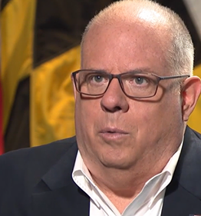
Hogan approves Board of Elections' plan on voting sites in November
“Maryland Gov. Larry Hogan issued a proclamation today allowing the Board of Elections to move forward with its plan for the November presidential election.
‘I remain very concerned that the Board’s decision to close nearly 80% of the polls will have the potential of creating long lines and unsafe conditions, with crowds of people being forced into too few polling places,’ Hogan said in a letter sent to the Board.
The plan authorizes 282 high schools in state to be used as voting centers on Election Day, instead of the approximately 1,900 precincts normally open as polling places on Election Day.
‘Expeditiously mailing the ballot applications, encouraging voting by mail, and protecting early voting options will be critically important steps needed to lessen the problems caused by your decision to close the vast majority of the polls,’ the governor said.”

Slide 16
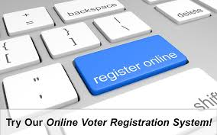
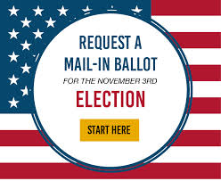
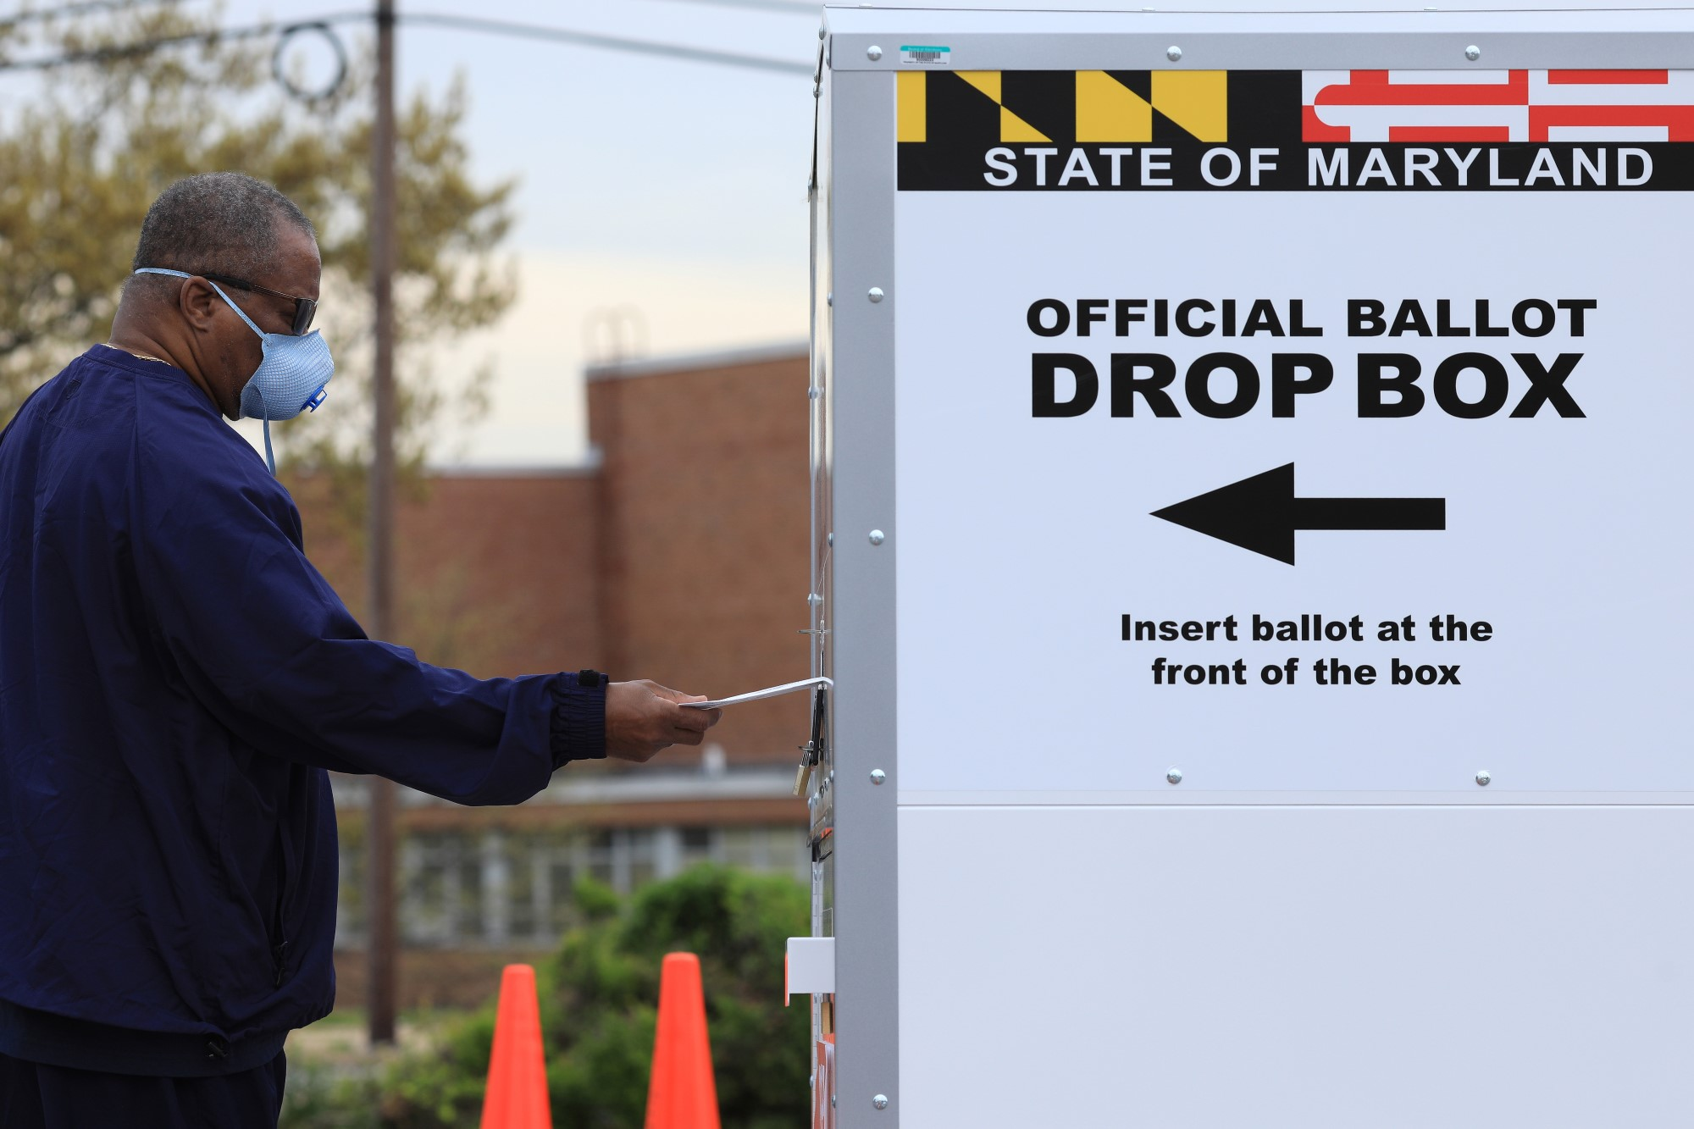
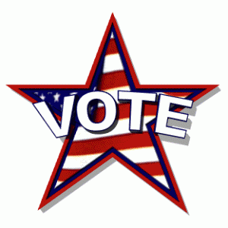
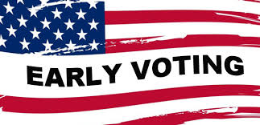
Maryland Voter Deadlines
Maryland Voter Registration Deadline:
October 13, 2020
Maryland Absentee Ballot Request Deadline:
October 20, 2020
Pick up at Board of Elections After October 20
Mail Voted Ballot Deadline:
Postmarked BEFORE
November 3, 2020
Maryland
Early Voting Period: From Monday, October 26, through Monday, November 2, 2020 from:
8 am to 8 pm.
U.S Election Day:
November 3, 2020
from 7 am until 8 pm
Online Registration Encouraged via Computer or
Smart Phone
Text: 77788 to VBM
Apply Now! The Earlier the Better!
Applications to be Automatically Mailed to Every Voter
Week of August 24
Hand Deliver EARLY to your Local Board of Elections Drop Box
Under 24 Hour Surveillance
Wear Mask & Social Distance!

Slide 17
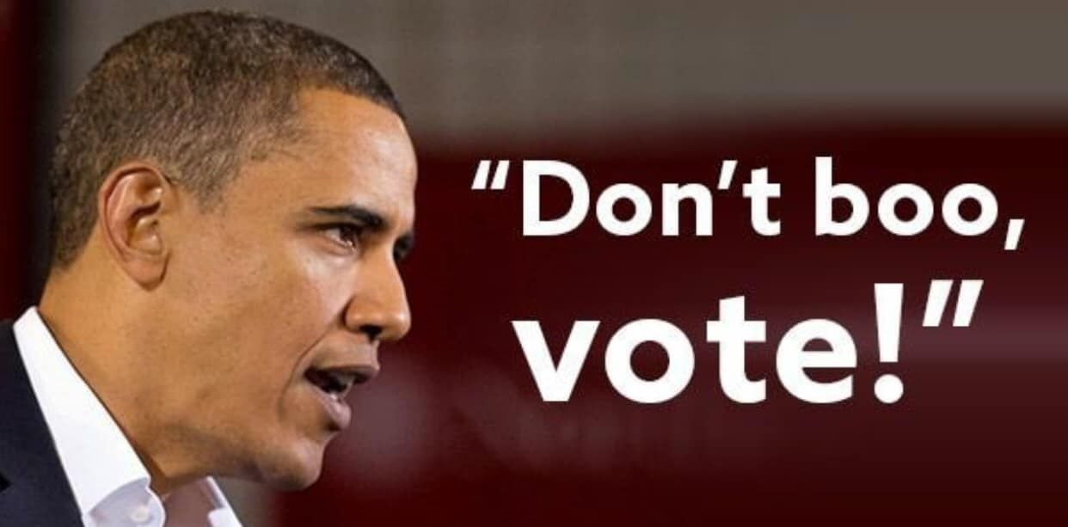

Slide 18
Baltimore District Voter Registration Forum
Question and Answer Period

Slide 19
Remember Upcoming Voter Events!
Thank You!!

Slide 20
Baltimore District Voter Registration Forum

