Slide 1
Retooling For Responsible Evangelism
153rd Annual Session of the Virginia Conference
Mrs. Devieta C. Moore, Supervisor
Bishop W. Darin Moore, Presiding Prelate

Slide 2
Retooling For Responsible Evangelism
www.bemoreamez.org/evangelism

Slide 3
SCRIPTURAL FOUNDATION

Slide 4
PRESENTATION
Our objective is to revisit the biblical mandate or imperative that commands us to go and make disciples. It is my desire to re-ignite and restore both individually and corporately our desire to reach the lost; and offer potential methods of “Retooling for Responsible Evangelism”.
Together we will revisit the biblical mandate that commands us to “go and make disciples”.
Together we will explore what evangelism is, is not, and potentially could be…
Together we will self-reflect and examine to what extent we have been complicit in the failure of the church to make disciples and acknowledge where we have done well .
We will challenge ourselves to continue “Retooling” for Responsible Evangelism

Slide 5
Retooling For Responsible Evangelism
What does it mean to retool?
Retooling means – to equip with something new, because what was previously thought to work does not; or to adapt, adjust, or alter the tools we have for maximum use or impact. I contend that we don’t need a whole lot of new stuff, let’s just start with caring about the people around us. How we retool for responsible evangelism?

Slide 6
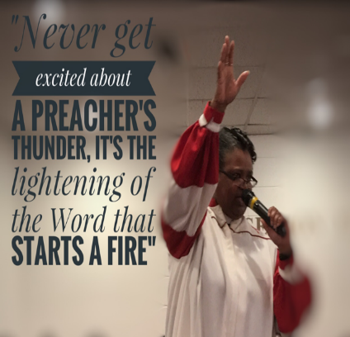
Evangelism Defined
The root of the word evangelism, evangel, is derived from the Greek word EUANGELION which is translated good news. From that same word, we derive the word gospel. Therefore, an “Evangelist” is a person who preaches or teaches the “Gospel”

Slide 7
Evangelism vs. Outreach – We confuse the two or make them synonymous when they are not. Outreach is not found in the Bible, the idea and concept are; but outreach implies action more than message, it is what we do. Evangelism is more about who and whose we are. Both outreach and evangelism are the work of the church, and bring honor to God, but only evangelism fulfills the Lord’s command to take the Good News to all the world.

Slide 8
Evangelism Deficits A few Indications that discipleship may not be our priority
Less than 3 people join our churches within our buildings zip code…
New members never process their conversion or salvation with anyone in the church, we believe new members class is sufficient…
New members class is more about our Discipline and denomination, rather than the study and understanding of God’s Word, Holy Living and people’s responsibility to live as citizens of the kingdom of God…
We wait more than a week to follow-up with new worshippers (no phone call, no email, no letter from the Pastor, nothing…)
90% of our ministry takes place inside the church rather than the community

Slide 9
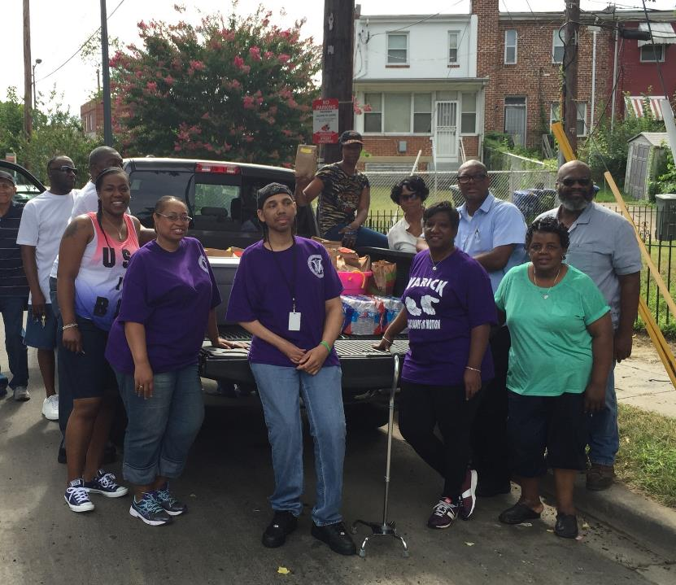
Why Evangelism?
The answer is simple, we evangelize because the Lord tells us to do it (Matt. 2:19-20). Saving (winning), the lost is the Lord’s purpose for coming and our purpose for being. There is one statistic that says, there are 3 billion created by God like God and for God, that are living without God. Our task has always been and remains, to make disciples not of ourselves but the Lord,
Jesus Christ.

Slide 10
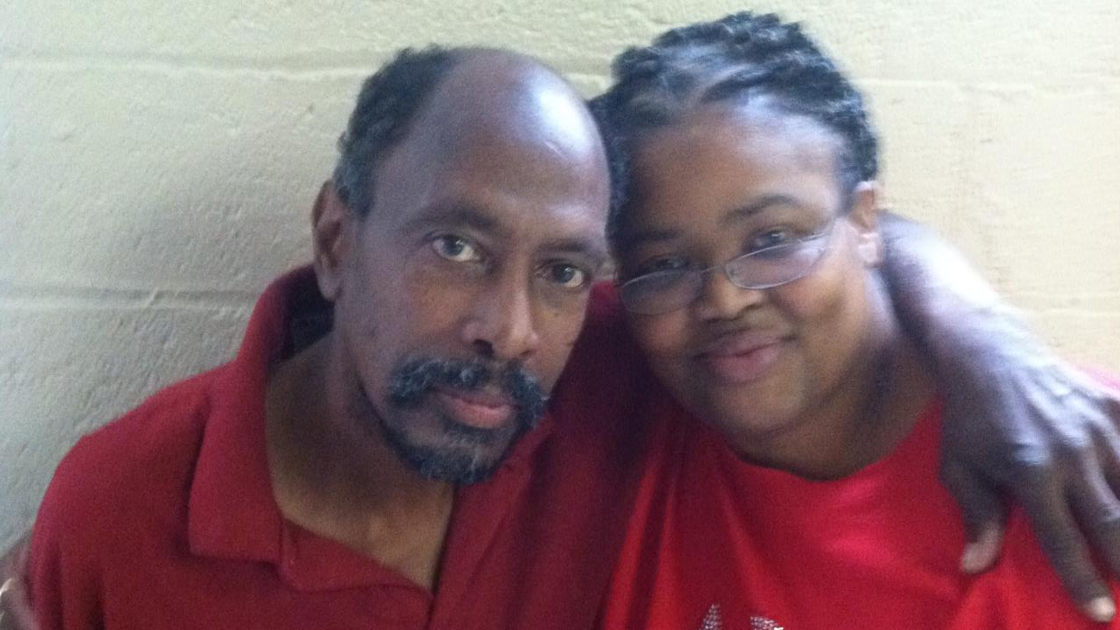
Evangelism is...
Meeting people where they are…

Slide 11
EVANGELISM IS…
Proactive – the biblical (imperative) mandate is to “go”.
The Preaching of the Gospel – John MacArthur (2005), says that “evangelism is the preaching of the cross of Christ, that He died for the sins of the world, that He arose from the dead, that Jesus is Lord and that we must believe the gospel before it can have any effect on our souls” (p.249).
Transformational - Effective evangelism, better yet biblical evangelism always results in changed lives.
Ongoing… it’s a Process - . Inwardly they (people) must be motivated to have fellowship with Christ; and outwardly they must become witnesses of Christ (Eims, 1978, p.51).

Slide 12
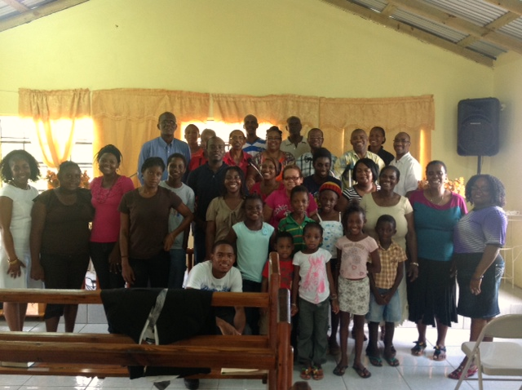
“Who would you rather have in your church, one hundred people who are 90% committed or ten people who are 100% committed?”

Slide 13
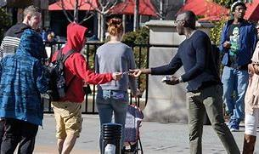
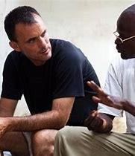
The Manner and Matter of Evangelism
If we use the New Testament church’s model for how the Great Commission was fulfilled, the odds are in our favor for success because this is the biblical model
Through personal evangelism-tell your story of how the lord saved you
Through public evangelism
And, through the planting of churches.

Slide 14
Retooling for Responsible/ Effective Evangelism
REPENTANCE
RETURNING
RETOOL, REGROUP AND REDIRECT

Slide 15
REPENTANCE AND EVANGELISM?
If we are going to retool, then repentance begins with the house of God (I Peter 4).
Repentance is the acknowledgement of our sin and a strong resolve and resolution to forsake it… So, Lord…

Slide 16
RETURNING AND EVANGELISM?
In Matthew 4:19, we find “follow me and I will make you fishers of men”. Booth (1991) says, “I think it is correct to say that if I am following, I am fishing, and if I am not fishing, I am not following. (p. 51)
We are challenged to take a serious look at what our biblical mandate is from the perspective of Pastor and people, because effective evangelism requires both Pastor and people to be active participants or agents in the work of multiplying and making disciples.

Slide 17
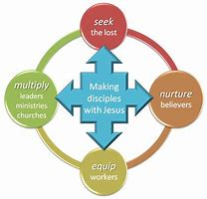
RETURNING TO OUR MISSION

Slide 18
RETURNING AND EVANGELISM?
Revisit some biblical concepts like:
Stewardship of the Pastor, conversion, salvation and discipleship
Pastor’s YOU are the key to effective evangelism… model beyond the pulpit
Motivate your people by being an EXAMPLE
Motivate by having clear EXPECTATIONS
Motivate by and through EXHORTATION
We motivate with the EXCITEMENT of new converts
We motivate through EVANGELIST effort – we must envision, implement and support

Slide 19
RETOOL, REGROUP AND REDIRECT
Evangelism today must be like Starbucks coffee, it must have a bold flavor that keeps producing consumers… Here are some personal examples of we’ve done in our ministry, some of which you are doing and more…

Slide 20
Simply Put,
Our Mission is the Great Commission

Slide 22
Conclusion
This entire workshop will have been an exercise in futility if we don’t leave here different than we came. If we don’t form some small groups of clergy and lay people who are willing to wrestle with how their church, their district and subsequently their Conference can recover its sense of being God’s agents of transformation, and how they can recover their passion for making disciples. There are enough spiritually lost and starving people to fill every congregation in this room.

Slide 23
Lets wake up to Responsible Evangelism
https://www.youtube.com/watch?v=RCTaGygj_z0

Slide 24
Retooling For Responsible Evangelism
www.bemoreamez.org/vaconference

